Slide 1

IKT 590 Spring Master's Thesis
Examining Ant Colony Optimization Performance for Ship Evacuation
Håkon Bakkevig Steinsholt and Daniel Aasen
Supervisors: Morten Goodwin and Ole-Christoffer Granmo, UIA

Slide 2
Outline
Introduction
Problem Statement
Methodology
Results
Conclusion

Slide 3
Introduction
Lives lost during a chaotic evacuation
Using pathfinding algorithms
Ant Colony Optimization
Simulated passengers using a smart phone application

Slide 4
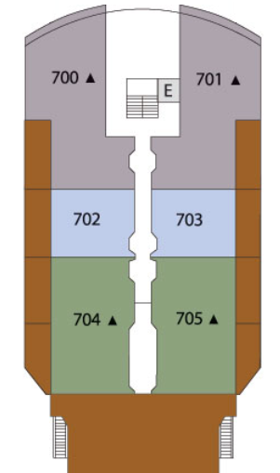
Problem Statement
Creating the simulation environment
Examining the performance of ACO
Comparing ACO to Dijkstra's algorithm

Slide 5
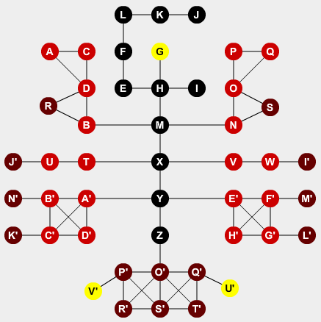
Simulation Environment
Creating the models
Capturing details
Dynamic elements

Slide 6
Ant Colony Optimization

Slide 7
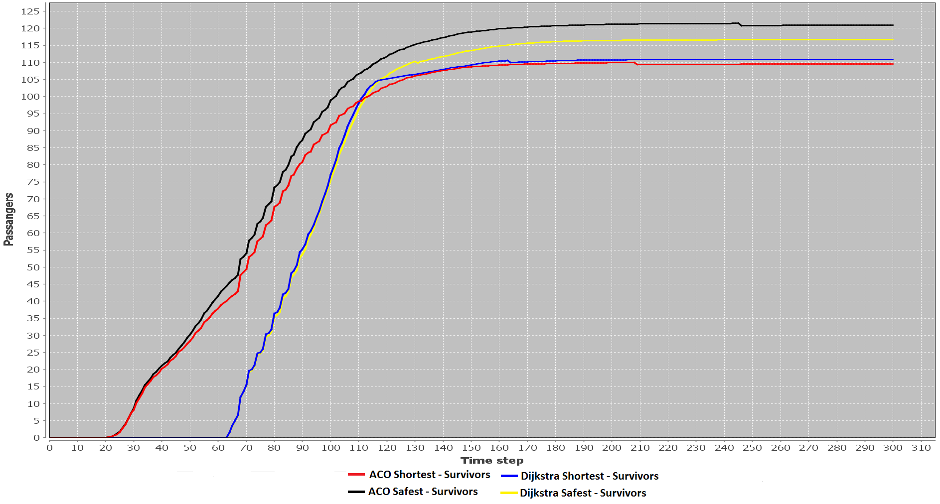
Results – Dikjstra only runned at start

Slide 8
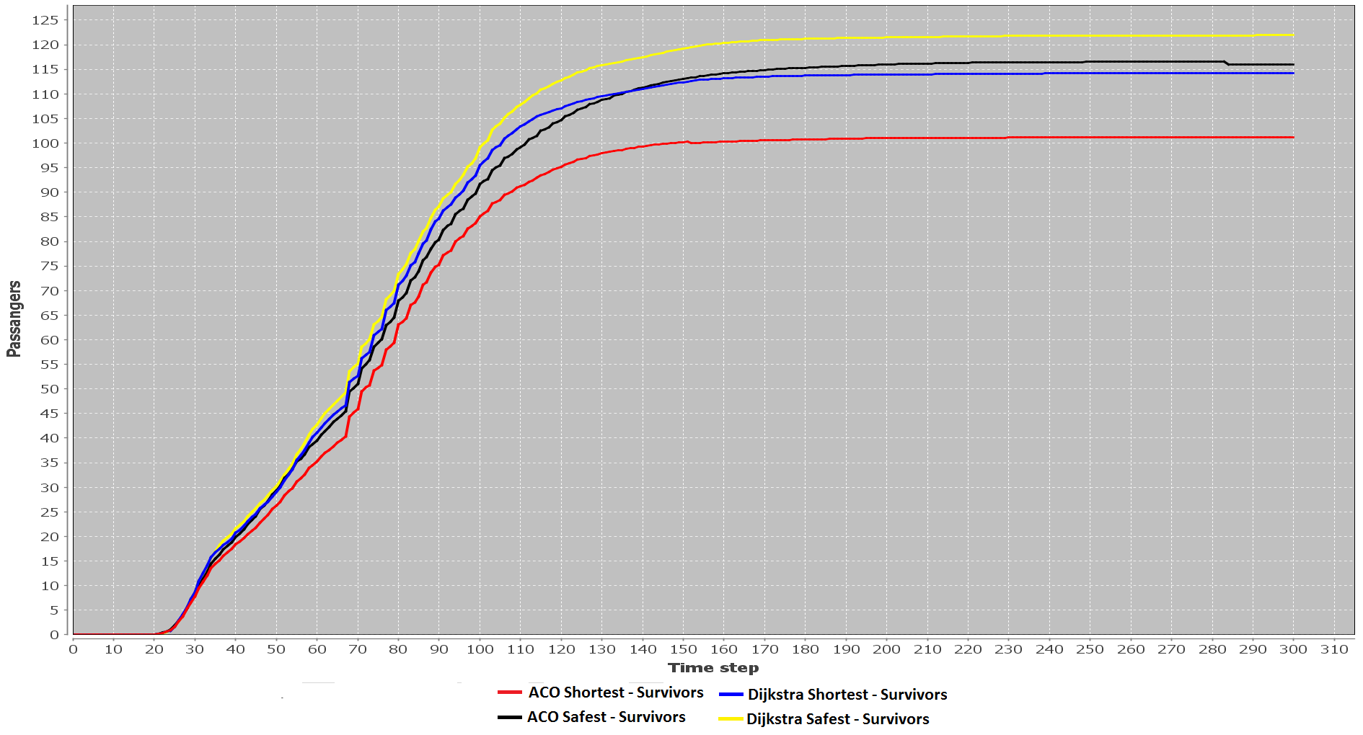
Results – Dijkstra runned at evrey step

Slide 9
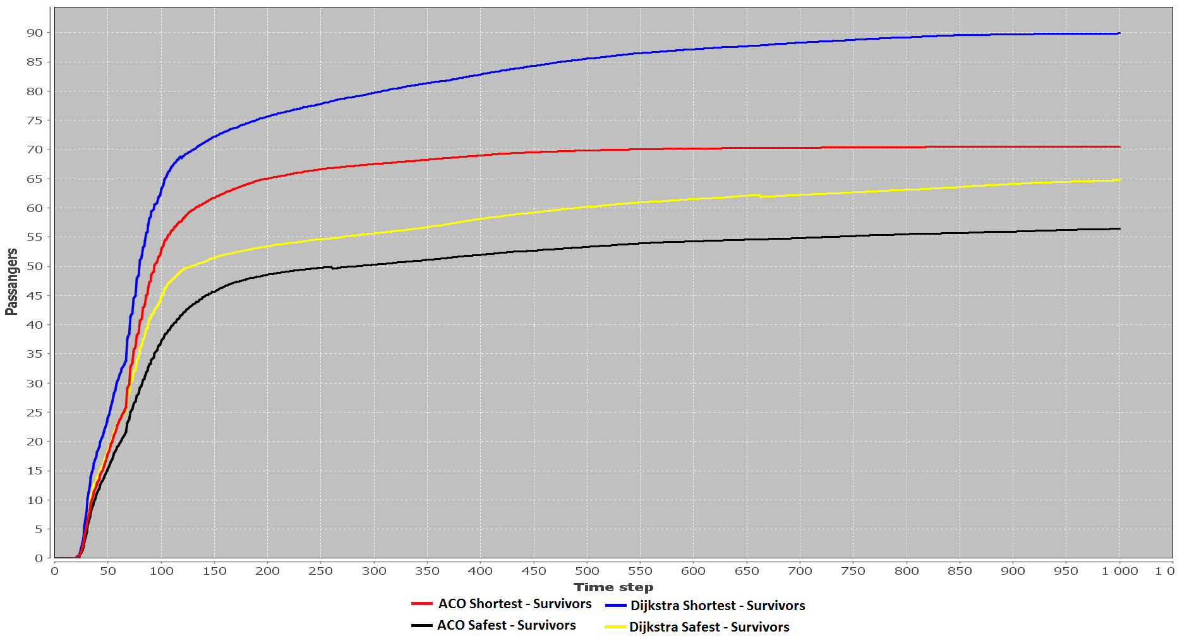
Results – High panic chance

Slide 10
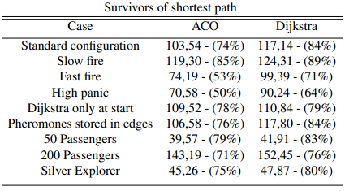
Results – Table with shortest path taken

Slide 11
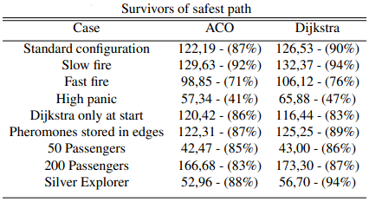
Results – Table with most safe path taken

Slide 12
Conclution

Slide 13
Questions?

